Slide 1
Career Guidance Web Portal Project Code: 116-T2/2015-AKL
Proposal Presentation
Pasindu Wijesekera
Kushan Wickramasinghe

Slide 2
Background – Problem
Sri Lanka has 15 public universities and only around 9% of students who sites for the GCE A/L examination can obtain to universities at present.
It shows the 91% of the students have limited opportunities in the public universities.
According to the university grant commission statics in Sri Lanka 2012, more than 79% of students who are eligible but not selected to enter public universities.
Those who cannot enter public universities have options for pursuing higher education which are not addressed to the students properly. There is no portal to guide them in the correct path.

Slide 3
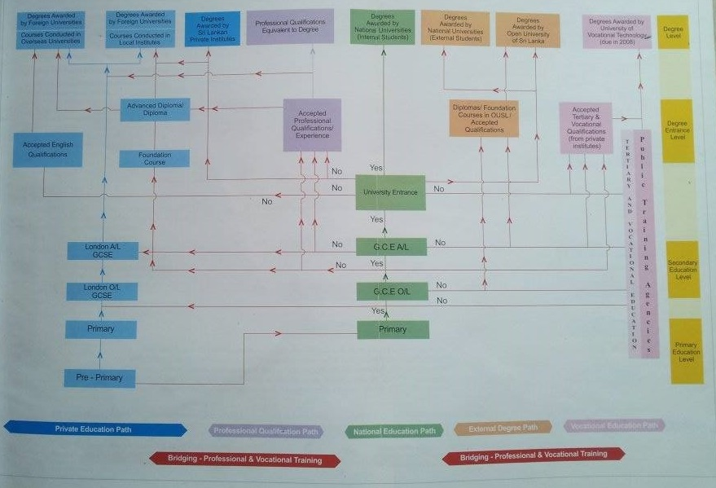
Background – Career flow path

Slide 4
Background – Project objective
Project main objective is to provide guidance for students who have completed A/Ls or O/Ls to their desired career path by focusing on their current state of qualification level.
The site should guide a person who haven't got the minimum requirements to enter an education path but still shows his way to archive his/her dream.

Slide 5
Scope
Project scope
This project will focus on delivering a web portal which include subscription module for the institute, agents and universities that are located in Sri Lanka and overseas. The institutes will be able publish their course details, minimum entry requirements for each course and the course fee.
System scope
The portal will enable to enter students current qualification (ex: A/L or O/L results) to the system and choose the qualification level (ex: Degree, Training) that the student want to archive. The system will then guide the next steps that need to follow in order to approach students’ target. This will list all the coursers available for each step.
Universities and agents should be able to make their own profile by subscription. Also add the course details and minimum entry requirements. This is process is applicable for foreign universities as well.
Agents who are associated with foreign universities will be able to publish their advertisements. The agents will be filtered according to the country and university.

Slide 6
Deliverables
Agents
Verification process
subscribe to profile
Manage universities and country details
Publish advertisements.
Website
Advertising spaces
Responsive
efficiency
Loading speed should in a high level.
Student
Advance filtering for course details.
Display filter options based on the qualification levels and user preferred education course and category.
Display career guidance paths to archive what student have included.
Save option of his/her preferred institute or course.
Save entered qualifications for the student.
Institutes/Universities
Verification process
Subscribe to profile
Manage university/institute details
Manage course details with minimum entry requirements
Add Links to the course details
Check The Hit count on Search.
Payment module for subscription.
efficiency

Slide 7
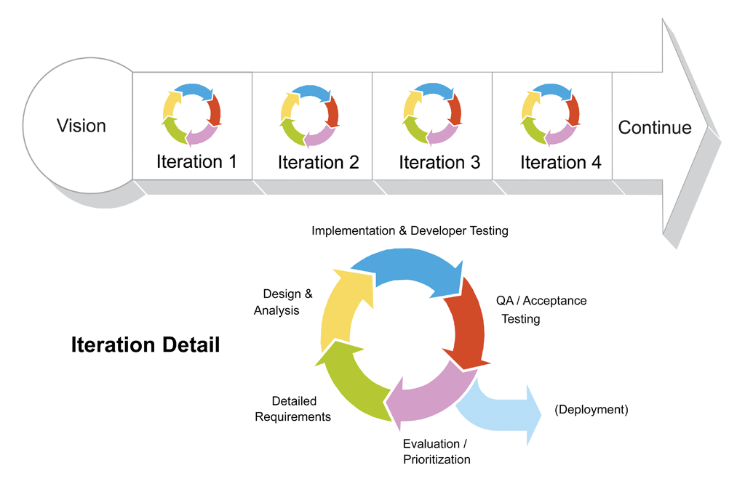
Methodology-SCRUM

Slide 8
Tools & Platforms
ASP.NET/C# will be used to develop this application.
HTML5,CSS3,jQuery, AJAX, XML
MS AZURE
Repository tools
Visual Studio 2012
MSSQL server 2012

Slide 9
Skill analysis
General | Current skill level | Required skill level | Gap
Project management | 6 | 7 | Watch online tutorials of handling SCRUM methodology.
Technical documentation
Technical
Database | 8 | 8
MVC architecture | 6 | 8 | Need to follow MVC tutorials on .NET platform.
Template design | 8 | 8
Web programming – ASP.NET | 9 | 9
jQuery AJAX with .NET | 6 | 8 | Need to follow tutorials to embed jQuery to .NET methods/ event handlers.
JSON | 7 | 8 | Tutorials for Handling JSON objects with ASP.NET MVC
Server Configuration | 5 | 8 | Practise online with AZURE

Slide 10
Project schedule
Career guidance web portal(116-T2-2015)Gantt Chart v2.1.mpp

Slide 11
Questions?

